Slide 1

Capstone Project Proposal
Student
Supervisor
Mahir Faisal (BSSE: 1316)
Dr. B M Mainul Hossain
Institution
Deadline of this Capstone
IIT, University of Dhaka
End of the Semester
1
Notes:
1

Slide 2
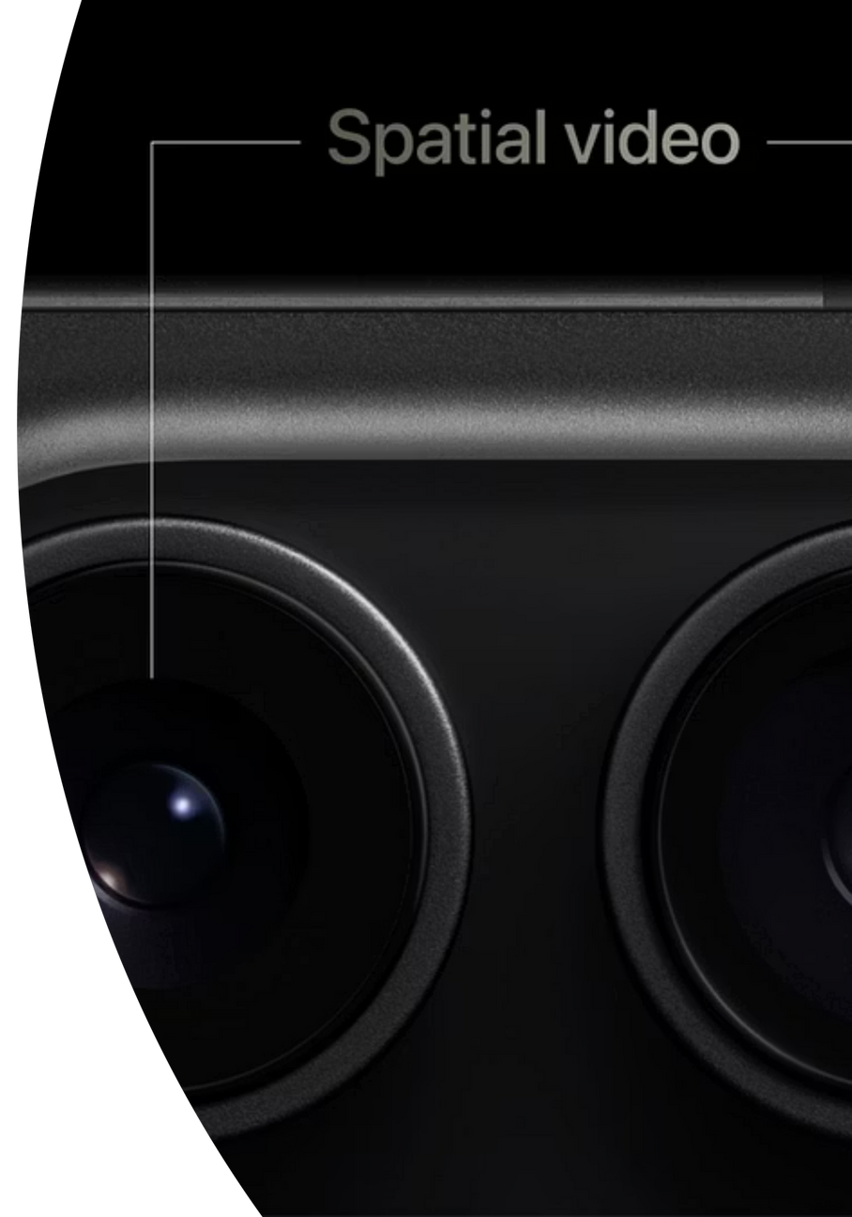

Real-Time Dual-Lens Photo Enhancer
A revolutionary system merging ultra-wide and telephoto images to capture both context and clarity in a single, perfectly balanced photograph.
2
Notes:
2

Slide 3

The Photography Challenge
Ultra-Wide Lens
Telephoto Lens
Captures broad context but sacrifices detail and clarity across the frame.
Delivers sharp precision and texture but misses the wider scene and spatial context.
The Gap
Users forced to choose between breadth of view or richness of detail, never both.
3
Notes:
3

Slide 4
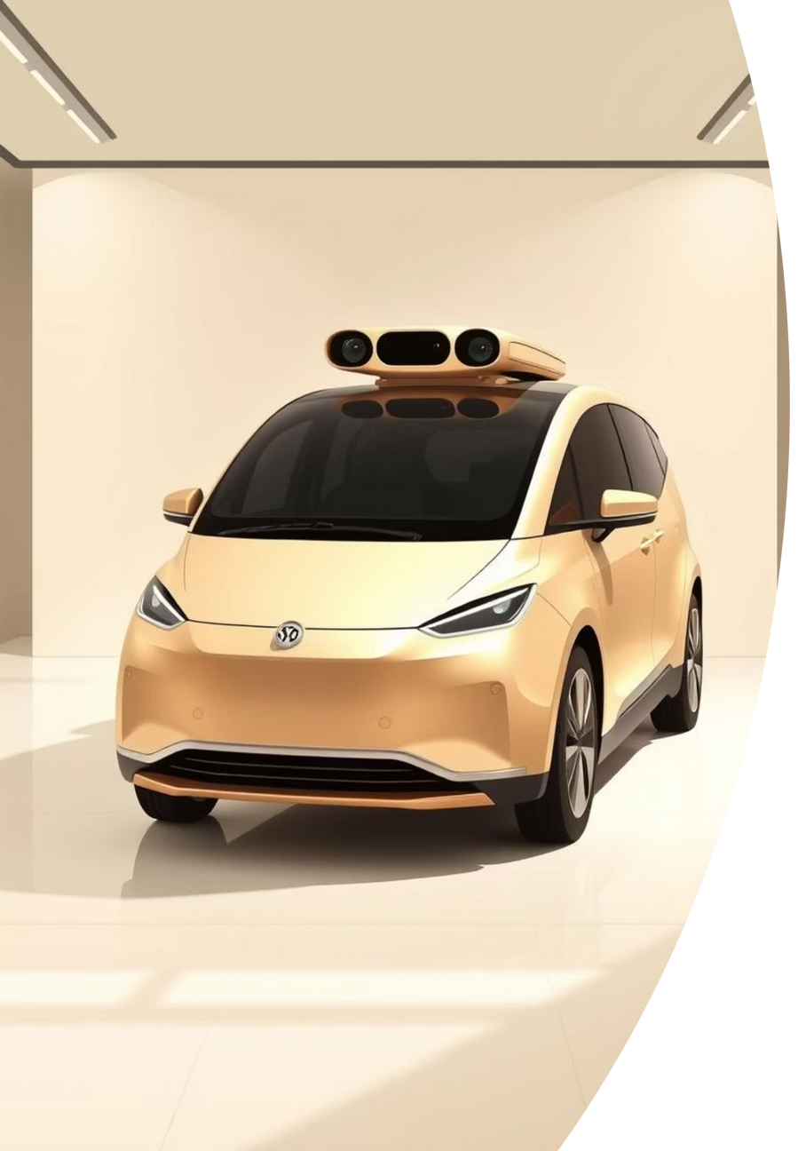

Critical Applications
This challenge extends beyond casual photography into high-stakes fields where both wide perspective and fine detail are equally essential.
Surveillance
Autonomous Driving
Requires comprehensive scene coverage with facial recognition precision.
Needs full environmental awareness plus detailed obstacle detection.
Professional Imaging
Demands artistic composition with technical perfection throughout.
4
Notes:
4

Slide 5
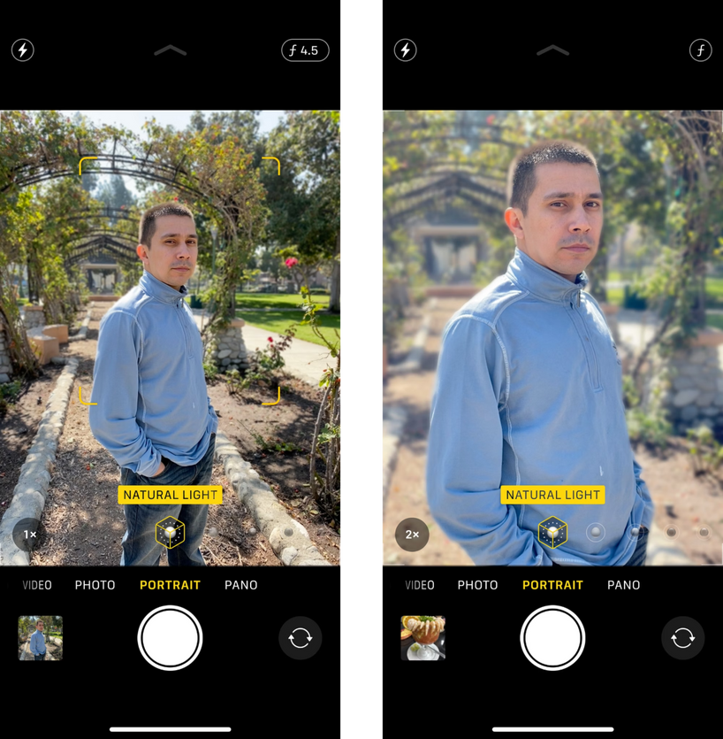
The Solution
Intelligent Image Fusion
A smart system that merges ultra-wide and telephoto images, preserving the broad perspective while enhancing sharp clarity across the entire frame. The result: balanced, natural, detailed photographs that capture how human eyes truly see the world.
5
Notes:
5

Slide 6
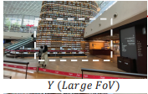
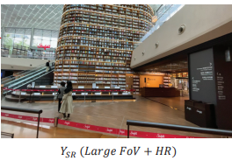
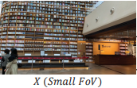
The Solution(cont.)
Large Fov (broad context, less detail) + Small Fov (sharp precision & clarity with narrower scene)
= Enhanced Image(Large Fov + Sharp detail & clarity)
6
Notes:
6

Slide 7


Building on ZeDuSR
Base Paper: ZeDuSR (Zero-shot Dual-lens Super Resolution)
Current Limitations:
- Zero-shot approach with high inference time
- Not suitable for real-time applications
- Dependency on MATLAB platform
- Used synthetic data
My Enhancements:
- Remove MATLAB Dependency: Pure PyTorch implementation for better performance
- Real-Time Optimization: Enhanced processing speed for live image capture
- Improved Efficiency: Optimized models for faster inference without quality loss
- Real data only: Ignored synthetic data
7
Notes:
6

Slide 8
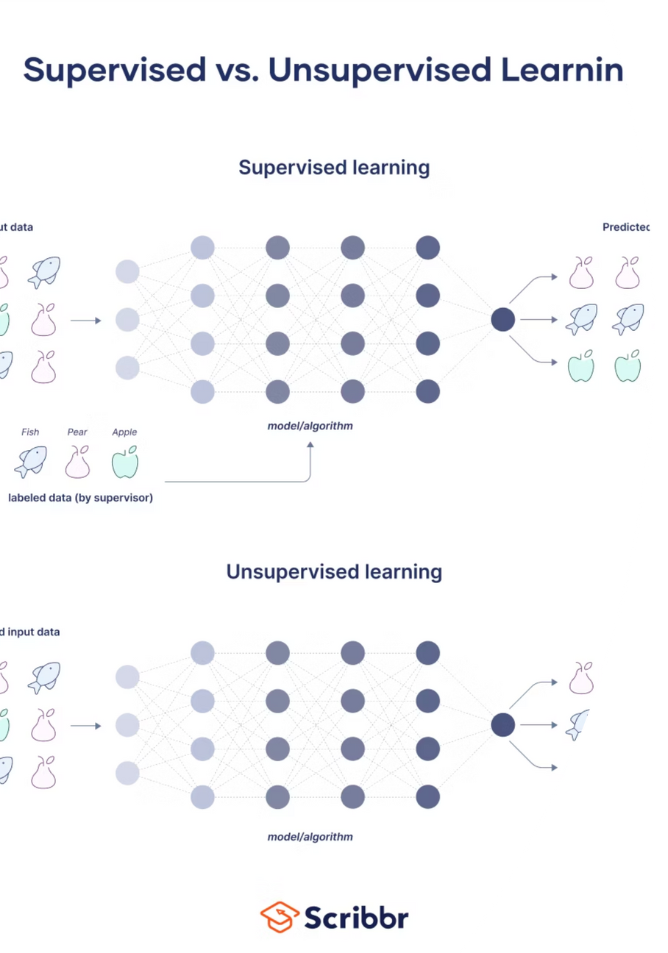
Zero-Shot Learning Advantage
Unsupervised Learning Power: Zero-shot learning eliminates the need for labeled training data, making it more practical for real-world applications.
No Training Data Dependency: Traditional supervised learning requires massive datasets with ground truth labels, which are expensive and time-consuming to create.
Generalization Capability: Zero-shot models can work on new, unseen data without retraining, unlike supervised models that are limited to their training distribution.
Cost-Effective: Removes the burden of data collection, annotation, and model retraining for different scenarios.
Adaptability: Can handle diverse imaging conditions and camera setups without requiring specific training for each configuration.
8
Notes:
7

Slide 9








Project Vision
Dual-Lens Input
Intelligent Processing
Ultra-wide and telephoto images captured simultaneously.
Deep learning models align and merge image data intelligently.
Smart Storytelling
Enhanced Output
Ordinary cameras become capable of capturing reality as we perceive it.
Single photo with broad context and sharp detail in perfect harmony.
9
Notes:
8

Slide 10

Technical Architecture
Core Technologies
Development Tools
Language: Python
Image Processing: OpenCV, NumPy, Pillow
Framework: PyTorch
Models: Lightweight deep learning models
Visualization: Matplotlib
Environment: Jupyter Notebook/VS Code, GPU server(if possible)
Dataset: CameraFusion
Version Control: GitHub
10
Notes:
9

Slide 11
Key Advantages
Natural Results
Real-Time Processing
Seamless fusion creates photos that look authentic, not artificially processed.
Lightweight models enable fast computation on standard hardware.
Universal Application
No Trade-Offs
Works with any dual-lens camera system across industries and use cases.
Eliminates the choice between breadth and detail delivers both simultaneously.
11
Notes:
10

Slide 12
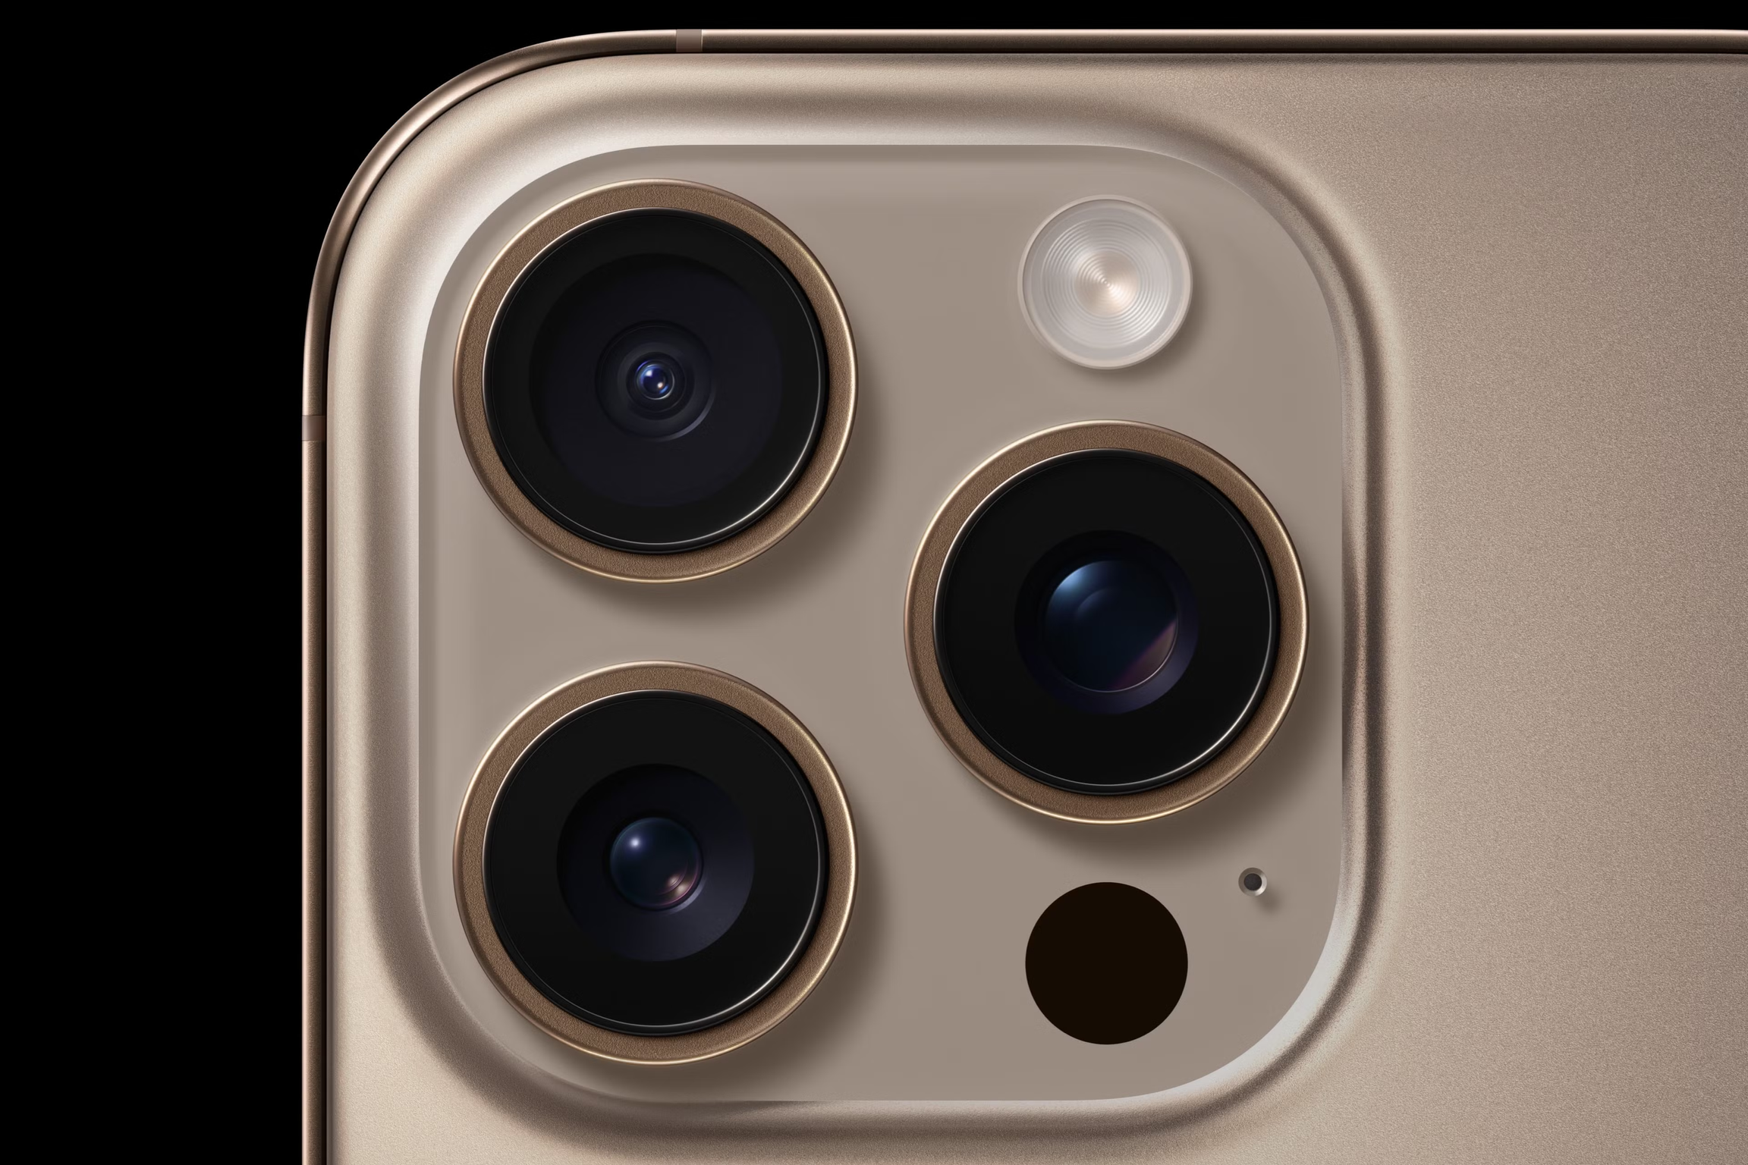
Impact & Future Potential
This project transforms how we capture and perceive visual information. By removing the fundamental limitation of single-lens photography, it opens new possibilities for consumer devices, professional imaging, autonomous systems, and surveillance technology.
Contact: Mahir Faisal | 01951351427 | Institute of Information Technology, University of Dhaka
12
Notes:
11

Slide 13
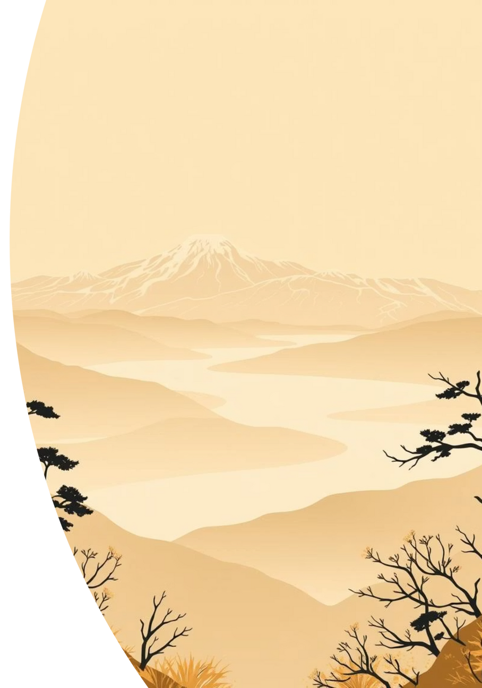
Thank You
13
Notes:
12

